Slide 1
Hierarchical Linear Model
ORLA 6641
March 9th, 2020
Presented by : Aki Osawa, Soojin Lee, Jingru Zhang

Slide 2
Today’s Journey
Introduction to Hierarchical Linear Model
Preparing Data for Hierarchical Linear Model
Application of a Basic Two-Level Multilevel Regression Model

Slide 3



What’s our interests?
Aki:
To what extent does participation in an education program for out-of-school learners predict passing the equivalency test in the Philippines, controlling for both learner-level and district-level covariates?
Soojin:
Is there a relationship between teacher professional development(PD) and their job satisfaction? To what degree does teachers’ job satisfaction vary across schools?
Do school level factors--administrative leadership practices of principals, number of students, school climate—moderate the relationship between PD and job satisfaction?
Jingru:
Does student math achievement vary across schools?
Do both individual-level AP course-taking pattern and school-level aggregate (or average) student AP course-taking pattern influence math achievement?
Do features of schools’ contexts and academic environments moderate the relationship between individual student AP course-taking pattern and math achievement?

Slide 4
Introduction to Hierarchical Linear Model
Rationales of using multilevel modeling
Equations
Intraclass correlation
Understand basic concepts and rationales of multilevel modeling

Slide 5
Why do we use multilevel modeling?
To capture group-level effects
To avoid the aggregation problem
To correct a violation of residual independence

Slide 6
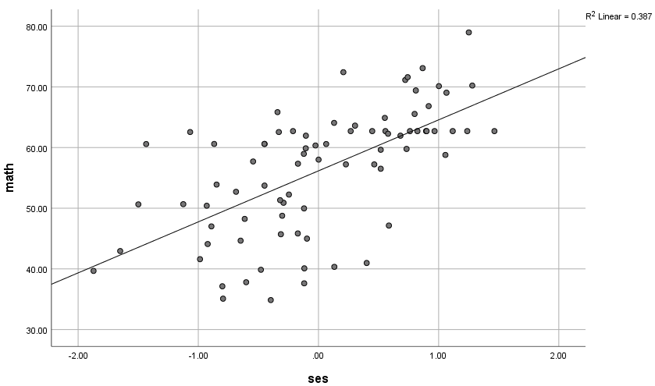
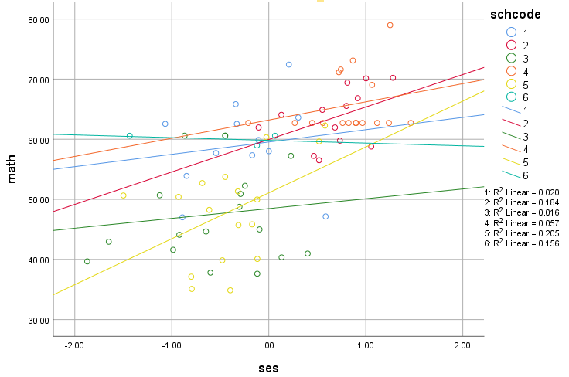
To capture group-level effects
Treating individuals if they were independent of their organizational groupings ignores the complexity inherent in the data and introduces a potentially important source of bias into the analysis (Heck, Thomas, & Tabata, 2013, p7)

Slide 7
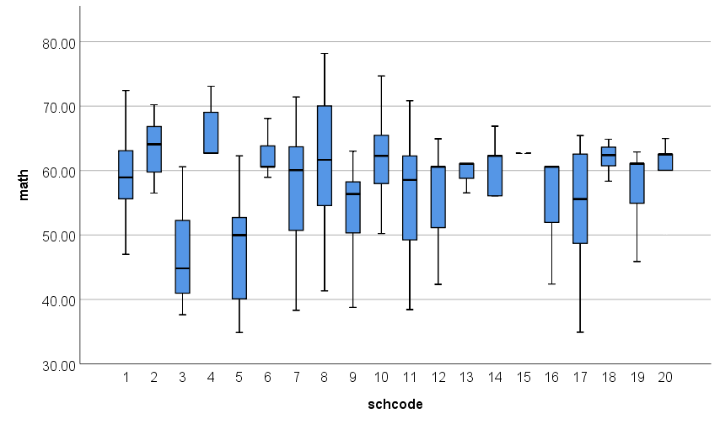
To avoid the aggregation problem
Within school variation
Between school variation
(variation in school means)
Adopted from EDPA 5002
Averaging estimates over groups causes ecological fallacy
Failing to acknowledge the potential variability present among individuals within groups (Heck, Thomas, & Tabata, 2013, p7)

Slide 8
To correct a violation of residual independence
Key OLS residual assumptions
Residual independence
Residual normality
Residual homoscedasticity
Failing to account for clustering of the data violates residual independence
The errors must be independent from observation to observation
In a regression model, all unobserved effects end up in the residuals, and the residuals of students in the same school may lose their required independence
Statistical dependence (O'Dwyer & Parker, 2014, p.2)
Notes:
Residuals = difference between any data point and the regression line (errors that are not explained by the regression line)
Residual normality: the errors must be normally distributed
Residual homoskedasticity: the variance of the errors must be the same at each level of every predictor

Slide 9
Why is statistical dependence a problem?
If we fail to account for clustering of the data, standard errors are going to be too small
Having small standard errors will lead to a greater propensity to commit a Type I error (Heck, Thomas, & Tabata, 2013, p.30)
Falsely concluding that an effect is statistically significant when it is not
Null hypothesis will be rejected more frequently than it should
Multilevel modeling produces unbiased estimates of the standard errors associated with the regression coefficients when the data are nested (O'Dwyer & Parker, 2014, p.2)

Slide 10
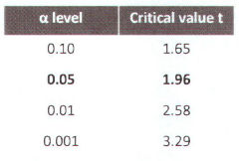
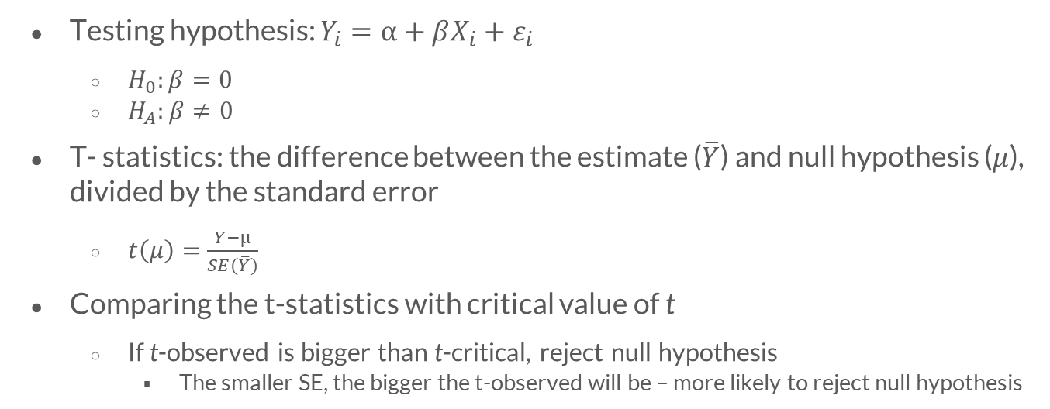
Why do we commit more Type I errors?
Testing hypothesis: $Y_{i}=α+βX_{i}+ε_{i}$
$H_{0}:β=0$
$H_{A}:β≠0$
T- statistics: the difference between the estimate ($\overline{Y}$) and null hypothesis ($μ$), divided by the standard error
$t\left(μ\right)=$ $\frac{\overline{Y}−μ}{SE(\overline{Y})}$
Comparing the t-statistics with critical value of t
If t-observed is bigger than t-critical, reject null hypothesis
The smaller SE, the bigger the t-observed will be – more likely to reject null hypothesis

Slide 11
Attempting to understand individuals’ behavior or attitudes in the absence of group contexts known to influence those behaviors or attitudes can severely handicap one’s ability to explicate the underlying processes of interest
(Heck, Thomas, & Tabata, 2013, p1)

Slide 12
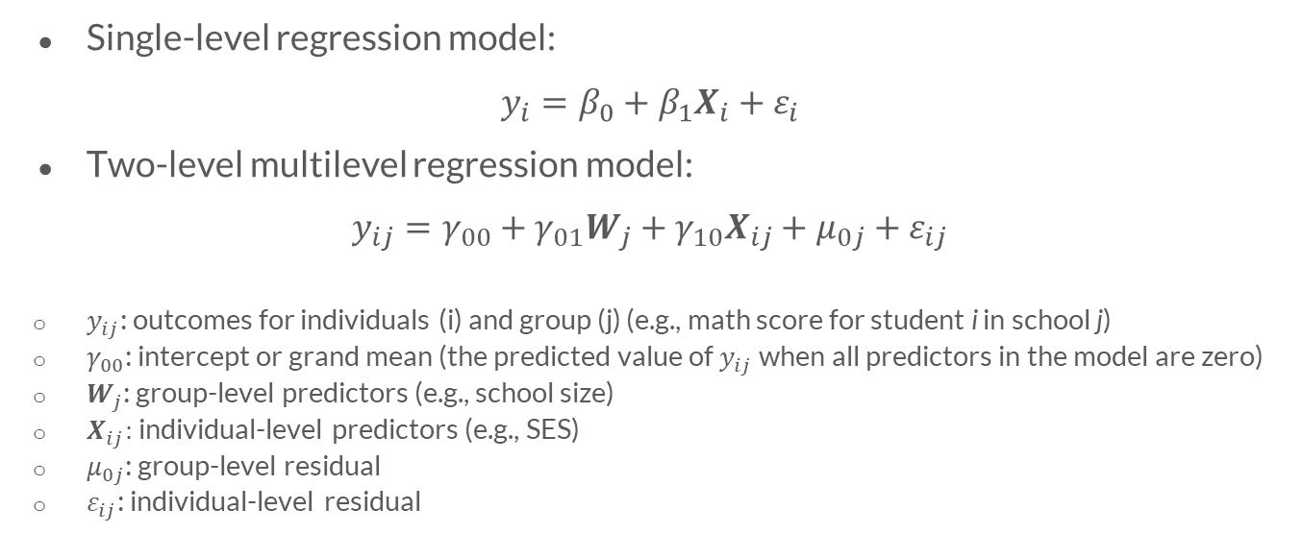
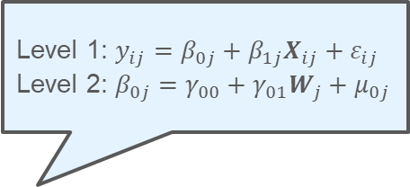
What is the equation of multilevel modeling?
Single-level regression model:
$$y_{i}=β_{0}+β_{1}X_{i}+ε_{i}$$
Two-level multilevel regression model:
$y_{ij}=γ_{00}+γ_{01}W_{j}+γ_{10}X_{ij}+{μ_{0j}+ε}_{ij}$
$y_{ij}$: outcomes for individuals (i) and group (j) (e.g., math score for student i in school j)
$γ_{00}$: intercept or grand mean (the predicted value of $y_{ij}$ when all predictors in the model are zero)
$W_{j}$: group-level predictors (e.g., school size)
$X_{ij}$: individual-level predictors (e.g., SES)
$μ_{0j}$: group-level residual
$ε_{ij}$: individual-level residual
Level 1: $y_{ij}=β_{0j}+β_{1j}X_{ij}+ε_{ij}$
Level 2: $β_{0j}=γ_{00}+γ_{01}W_{j}+μ_{0j}$

Slide 13
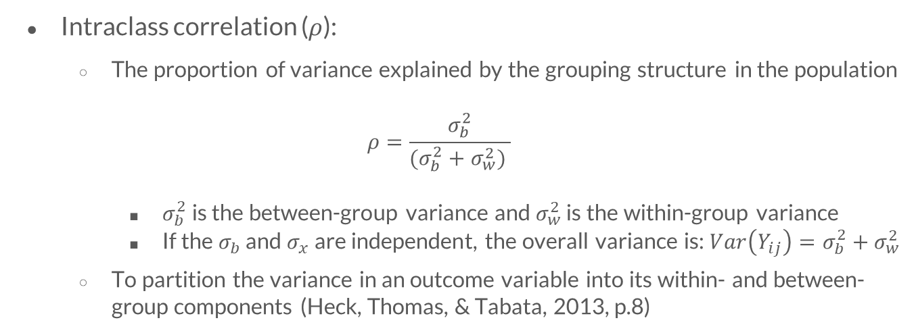
How do we quantify between-group variance?
Intraclass correlation ($ρ$):
The proportion of variance explained by the grouping structure in the population
$$ρ=\frac{σ_{b}^{2}}{(σ_{b}^{2}+σ_{w}^{2}) }$$
$σ_{b}^{2}$ is the between-group variance and $σ_{w}^{2}$ is the within-group variance
If the $σ_{b}$ and $σ_{x}$ are independent, the overall variance is: ${Var\left(Y_{ij}\right)=σ}_{b}^{2}+σ_{w}^{2}$
To partition the variance in an outcome variable into its within- and between-group components (Heck, Thomas, & Tabata, 2013, p.8)

Slide 14
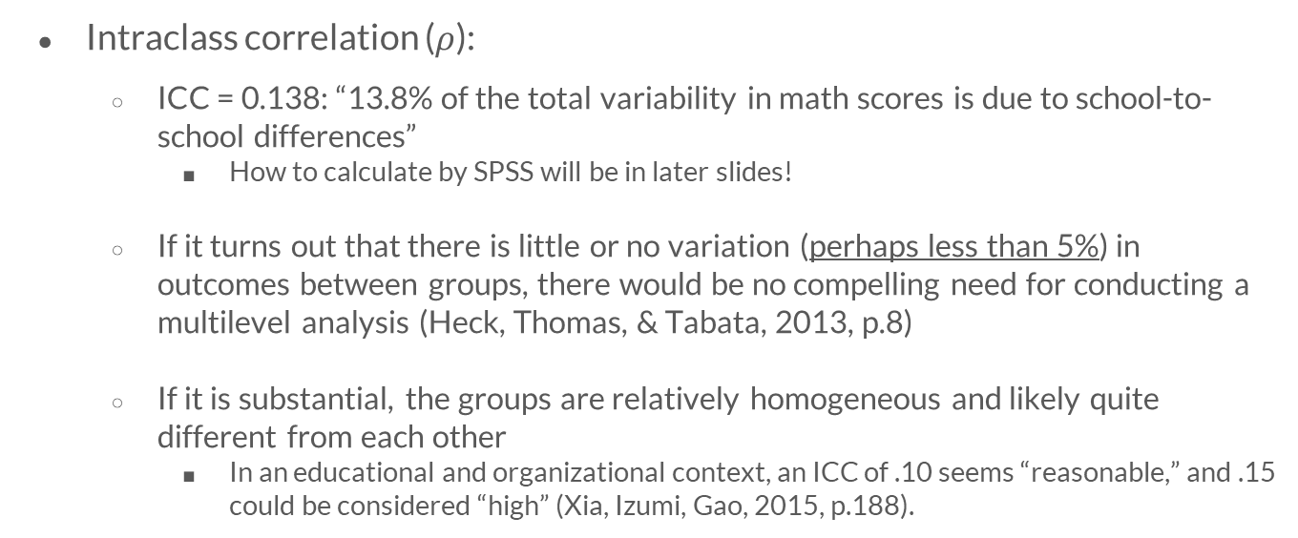
How do we quantify between-group variance?
Intraclass correlation ($ρ$):
ICC = 0.138: “13.8% of the total variability in math scores is due to school-to-school differences”
How to calculate by SPSS will be in later slides!
If it turns out that there is little or no variation (perhaps less than 5%) in outcomes between groups, there would be no compelling need for conducting a multilevel analysis (Heck, Thomas, & Tabata, 2013, p.8)
If it is substantial, the groups are relatively homogeneous and likely quite different from each other
In an educational and organizational context, an ICC of .10 seems “reasonable,” and .15 could be considered “high” (Xia, Izumi, Gao, 2015, p.188).

Slide 15
Preparing Data for Hierarchical Linear Model
Datasets
Sample size
Missing data
Five primary procedure
Standardized ad unstandardized coefficients
Grand-mean and group mean centering
Overview of the data management

Slide 16
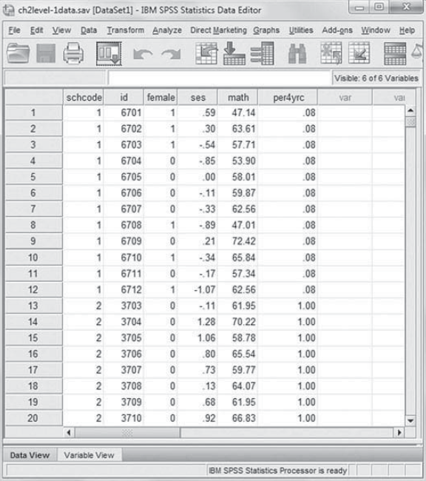
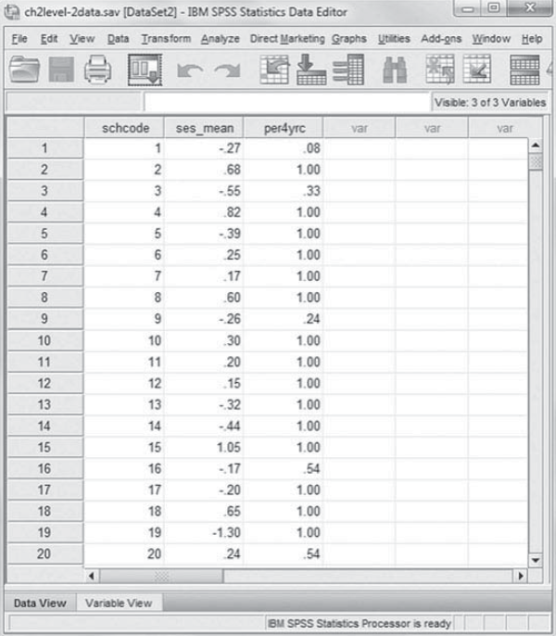
Datasets
Level 1 : Lowest level (usually defined by the individuals)
Level 2 : School level
Data of all 419 schools, including school identifier and aggregated data from Level 1 file
Including higher order group membership for each of the 6,871 students
https://www.routledge.com/Multilevel-and-Longitudinal-Modeling-with-IBM-SPSS-2nd-Edition/Heck-Thomas-Tabata/p/book/9780415817110
Notes:
2 approaches: single-equation approach, multiple-equation approach.
Multiple-equation approach requires a separate data set for each level of data being analyzed. Level 1 data would describe students data, including information about higher order group membership(for this example, we have school membership for each of the 6,871 students in the file). Level 2 data consisted dataset of all 419 schools, including school identifier and aggregated data from the Level 1 student file.
Note: We are using IBM SPSS MIXED, which uses the single-equation approach and one omnibus file containing data on each level of the analysis.

Slide 17
Sample size
Multilevel models are data demanding. Adequate sample sizes are needed at each level to ensure sufficient power to detect effects (Heck, Thomas, & Tabata, 2013, p.5)
Typically, the minimum sample size refers to the highest level in the data hierarchy (O'Dwyer & Parker, 2014, p.7)
Number of schools
Guideline for sample-size requirements?
Models with fewer than 20–25 groups may not provide accurate estimates of the regression coefficients and their standard errors, or of the variance components and their standard errors (O'Dwyer & Parker, 2014, p.7)

Slide 18
Missing Data
Users should be careful about imputing values for Level 2 variables within the large dataset that contains missing values (Heck, Thomas, & Tabata, 2013, p.26)
Imputation routine will borrow information from similar individuals who are not in the same group
If data are missing at the group level for individuals in the data set, we must ensure that the same value is imputed for the group variables for all individuals within the group
Notes:
More to discuss in the later section

Slide 19
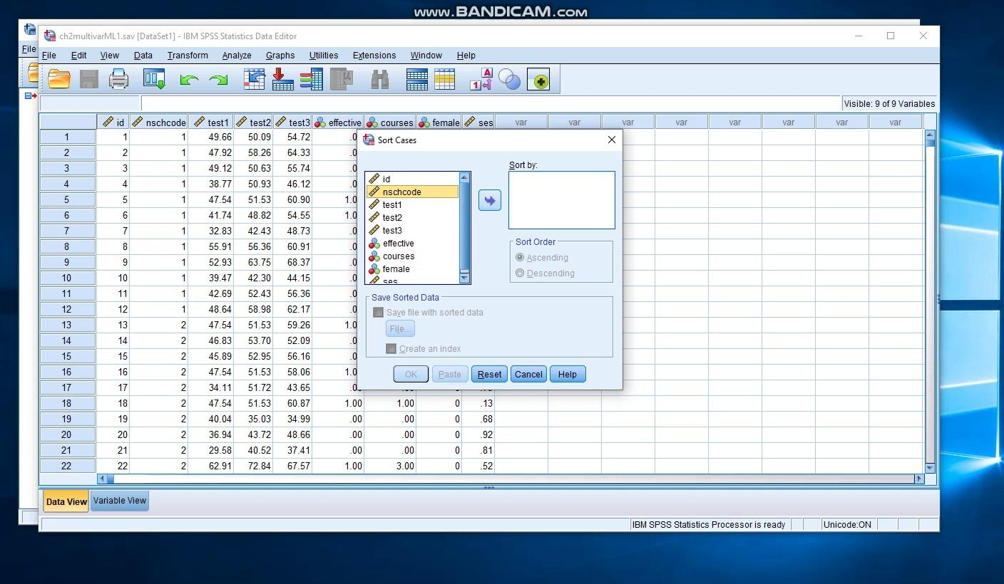
Five primary procedures
RECODE : changes, rearranges, or consolidates the values of an existing variable
COMPUTE : creates new numeric variables/modifies the values of existing string or numeric variables
MATCH FILES : combines variables from IBM SPSS-format data files
AGGREGATE : aggregates groups of cases in the active data set into single cases and creates a new aggregated file or creates new variables in the active data set that contain aggregated data. The values of one or more variables in the active data set define the case groups
VARSTOCASES : restructure complex data structures into a data file in which those measurements are organized into separate rows of a single column
Example: Match files SPSS procedure
SPSS ver.26
<Click for hyperlink
Notes:
MATCH FILES example in the book has different instruction on SPSS. I think this might be due to differences in SPSS versions? Using ver.26, this video clip shows how to combine/match files.

Slide 20
Compute Standardized & Unstandardized Coefficients
Goal:
Make the interpretation of intercept easier. (The intercept is interpreted as the expected value of the outcome variable, when all explanatory variables have the value zero.)
Perform a transformation of the X-variables that make ‘zero’ a legitimate, observable value
Rationality & Advantages
Linear transformations of the explanatory variables do not change the essence of the regression estimates.
Process
Centering
Standardization
Interpretation:
The expected variances for the ‘average’ subject
Extension

Slide 21
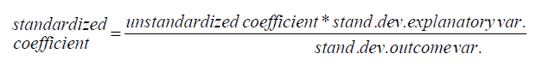
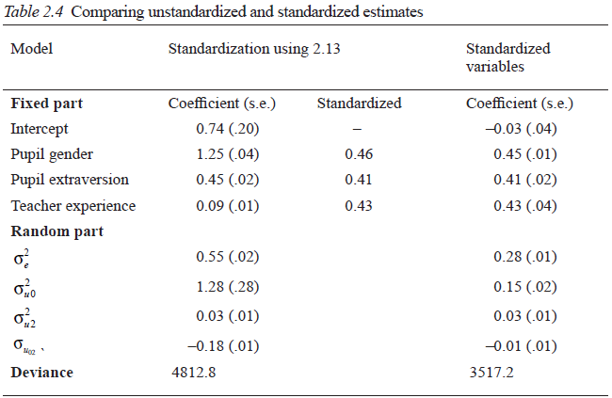
Calculating Standardized Coefficients
If the goal of analysis is to compare parameter estimates from different samples to each other→ use unstandardized
Standardize before putting them into the multilevel analysis (careful with changes in estimates of the variance, SE)
Or derive the standardized regression coefficients from the unstandardized coefficients
Table 2.4 compares using standardized variables and standardized regression coefficients
Hox, Moerbeek, Van de Schoot (2010)
Notes:
Joop Hox
(If you standardize variables before putting them into analysis) this would ALSO change the estimates of the variance components & standard errors
Table 2.4 shows that the standardized regression coefficients are almost the same as the regression coefficients estimated for standardized variables.
The small differences in Table 2.4 are simply due to rounding errors. However, if we use standardized variables in our analysis, we find very different variance components and a very different value
for the deviance. This is not only the effect of scaling the variables differently; the covariance between the slope for pupil extraversion and the intercept is significant for the unstandardized variables, but not significant for the standardized variables.

Slide 22
Grand-mean Centering
Grand-mean centering (i.e., where the grand mean is subtracted from individuals’ levels of family income) often facilitates the interpretation of a multilevel model since it results in an intercept that can be interpreted as the expected value of Y when the predictor is at its grand-mean value (0). The standard deviation, however, remains in the original metric.

Slide 23
Grand-mean v.s. Group-mean centering
Grand-mean Centering: the overall or grand mean is subtracted from all values of a variable.
Group-mean Centering: the group means are subtracted from the corresponding individual scores.
As Raudenbush and Bryk (2002) suggest, it often desirable to group-mean center a predictor if the focus of the analysis is on producing an unbiased estimate of the within-group (Level 1) effect, since group-mean centering results in a Level 2 mean that is unadjusted for the Level 1 predictor.

Slide 24
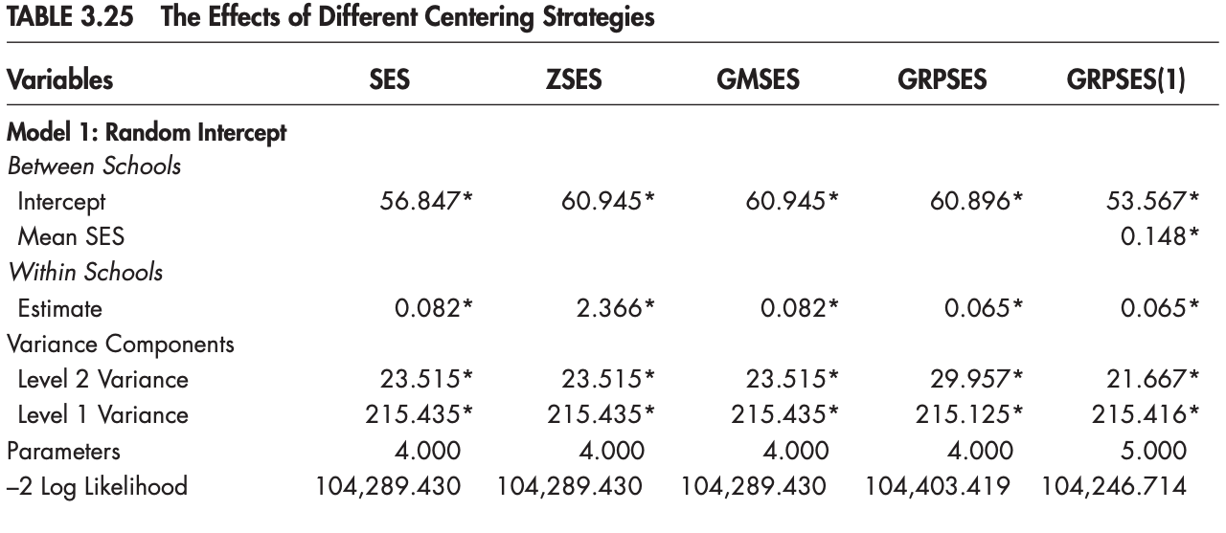
Other methods for centering

Slide 25
Application of a Basic Two-Level Multilevel Regression Model
Building a Two-Level Model
Building a Multilevel Model with IBM SPSS MIXED
Analysis method
Understand how to build a multilevel regression model & how to do in SPSS
Notes:
Model building strategies can be either top-down or bottom-up
Top down starts with all the fixed effects and possible interactions in the model, and with a rich random structure followed by removal of non-significant effects.
Here, we will start with the mostly used strategy, which is bottom-up. It starts with a simple model and proceed by adding parameters, which are tested for significance after they have been added.
In most cases, the procedure starts by building up fixed part and then the random part.

Slide 26
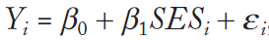
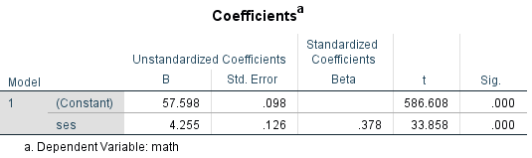
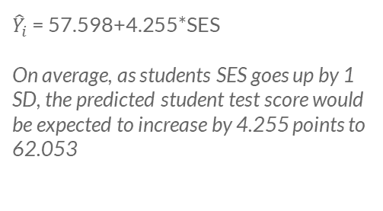
Building a Two-Level Model (Heck, Thomas, & Tabata, 2013)
RQ: Is there a relationship between students’ SES background and their achievement levels in math?
Intercept: the expected math achievement score for a student whose SES is 0
Slope coefficient: the expected change in math achievement for a 1 unit change in SES
${\hat{Y}}_{i}$ = 57.598+4.255*SES
On average, as students SES goes up by 1 SD, the predicted student test score would be expected to increase by 4.255 points to 62.053
Notes:
We will begin with a single level analysis, which consider only the students not their nesting within schools.
It should be noted that, SES is standardized, the mean is 0 and the SD is 1.0. In other words, a score of 0 on SES represents the score for a person whose SES background is equal to the SES grand mean for the sample.
In a single-level linear model, the coefficients describing the intercept and slope are generally considered as fixed values in the population estimated from the sample data.
(problems with single level?!)

Slide 27
Building a Two-Level Model
Fixed intercept and slope for student SES and math achievement
SES-achievement slopes in six schools
Notes:
As mentioned earlier in our introduction, multilevel models imply that individuals are clustered in higher order social groupings. In these types of studies, simple random sampling does not hold because people clustered in groups will tend to be ‘similar’ in some ways. Where there are clustered data, it is likely that there is a distribution of both intercepts and slopes around their respective average fixed effects. In this case, we would like to investigate the random variability in intercepts and slopes across the sample of higher level units in the study.

Slide 28
Research Questions & Data
Does student math achievement vary across schools?
Do both individual-level SES and school-level aggregate student SES influence math achievement?
Do features of schools’ contexts and academic environments moderate the relationship between individual student SES and math achievement?
DATA: 6,871 secondary students in 419 schools
Randomly varying intercept (math achievement level)
Randomly varying slope (the individual SES-math achievement relationship)
Notes:
Research questions provide an illustration of building two-level model to investigate a randomly varying intercept and a randomly varying slope. Moving from simple question of Is there a relationship between students’ SES background and their achievement levels in math? to further analysis of whether there is variance across schools, whether some predictors moderate the relationship.

Slide 29
Building a Multilevel Model (SPSS MIXED)
Step 1: Examining Variance Components Using the Null Model
Step 2: Building the Individual-Level (or Level 1) Random Intercept Model
Step 3: Building the Group-Level (or Level 2) Random Intercept Model
Step 4: Adding a Randomly Varying Slope (The Random Slope and Intercept Model)
Step 5: Explaining Variability in the Random Slope (Mode Complex Random Slopes and Intercept Models)

Slide 30
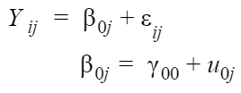
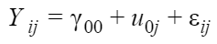
Step 1: examining variance components using the null model
Specification of the null model (Intercept only model)
→ researchers determine how much of the variance in math achievement lies between the schools in the sample
Notes:
Specifying no predictors model to partition the variance in the outcome into its within and between groups components

Slide 31
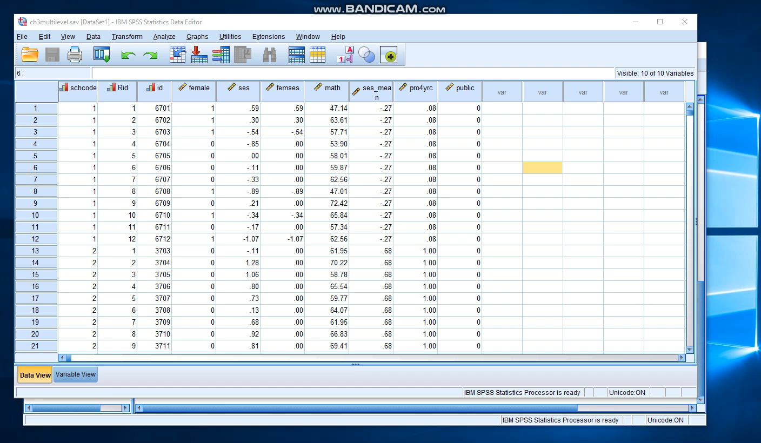

Slide 32
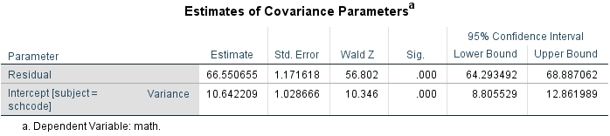
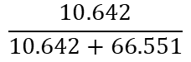
Step 1: examining variance components using the null model
Intercept-only model is useful because it gives us an estimate of the intra-class correlation
$$\frac{10.642}{10.642+66.551}$$
ICC =
13.8% of the total variability in intercepts within and between schools
Notes:
The ICC is interpretable as:
• The proportion of overall variation in outcomes “accounted for” by group assignment
• Expected correlation between pairs of observations from the same group
• 13.8% of the overall variation in outcomes is due to school sorting
• Within school correlation in math scores is 0.14

Slide 33
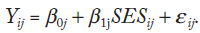
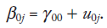
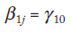
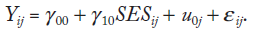
Step 2: Building the individual-level(Level 1) random intercept model
A model to examine variability in intercepts across schools
3 equations we primarily use in multilevel analysis
within-group(individual-level) equation
between-groups intercept equation
between-groups slope equation
School level avg slope
Individual school coefficient
School level intercept
Individual school means
Where we treat the within-group slope as fixed(does not vary across schools), we use the second equation
Notes:
In this step we assess the contribution of each individual level explanatory variable. The significance of each predictor can be tested, and we can assess what changes occur in the first-level and second-level variance terms.

Slide 34
Fixed Effect and Random Effect
Random Effect: deviation from average group effect for group j
Fixed Effect: the average intercept over groups when all predictor are zero
In this case:
Two fixed effects (the intercept and SES) ;
One random effect (the Level 2 variance component describing variability in the intercept across schools in the sample).

Slide 35
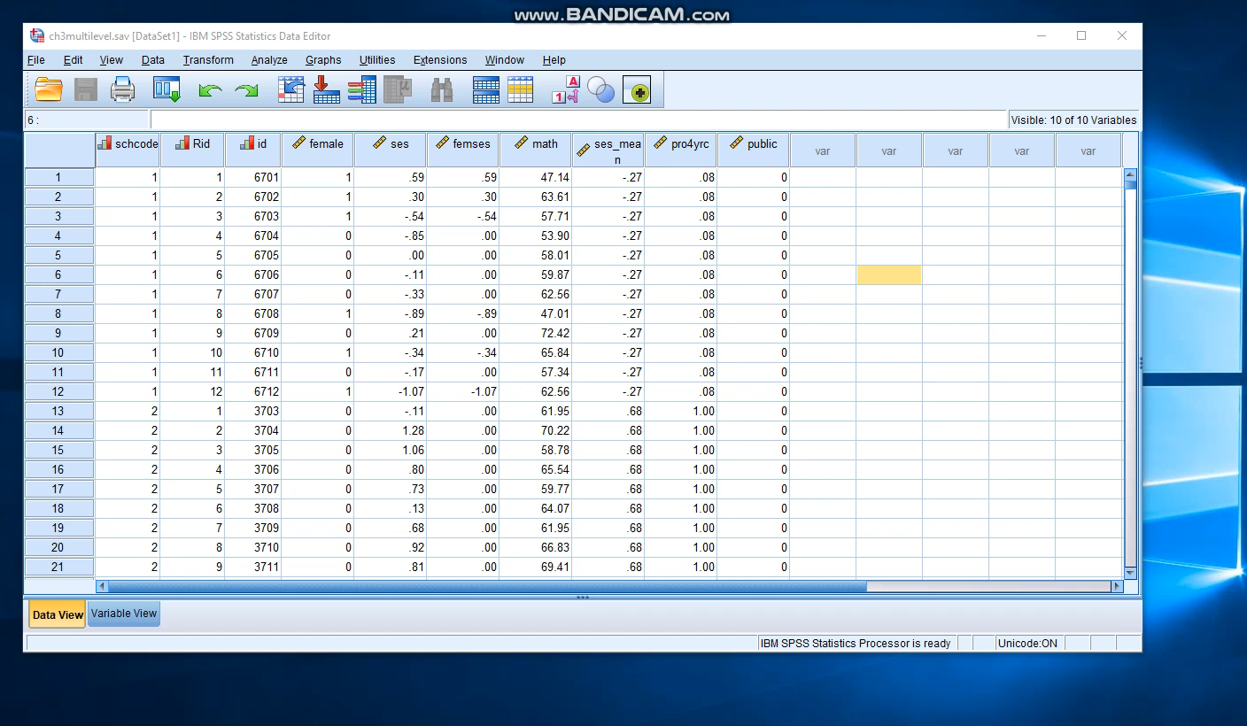

Slide 36
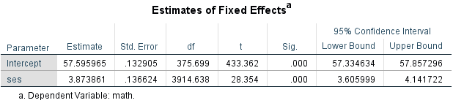
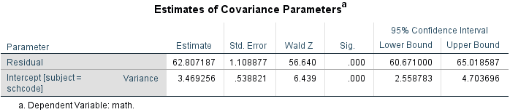
Step 2: Building the individual-level(Level 1) random intercept model
Two fixed-effect parameters to be estimated (intercept, within-school parameter)
Two variance parameters(random Level 2 variance and the Level 1 residual variance)
Slope for SES = 3.874, SE=0.137
t-ratio = 28.354
Single-level: 𝛃= 4.255, SE=0.126
t-ratio = 4.255/0.126= 33.858
Addition of the within-group predictor(SES) reduces the residual variability
(66.555→ 62.807)
ICC = 3.469/ 3.469+62.807 = 0.052
(13.8% → 5% )
Within schools Wald Z = 56.640, p<.001
Between schools Wald Z = 6.439, p<.001
Notes:
Large F-ratio associated with SES(803.654) → student SES is significantly related to student math score
The average school mean adjusted for student SES is 57.596, the standard error is 0.133. Not really interested in t test, as it only tells us whether the intercept is equal to 0.
(What level each variable is measured in the model) 375.7 degrees of freedom are consistent(419 schools in the sample), 3914.6 are consistent with a variable measured at Level 1(6871 students)
(Comparing to OLS) The intercepts are very similar OLS model 57.598 vs. multilevel 57.596 (OLS intercept described the average student achievement in the sample, without regard for students’ school settings. Standard errors from OLS 0.098, level 1 multilevel is 0.133, which is 36% larger.
(investigate slope) slope for SES, Beta = 3.874, SE=0.137. This is quite different from a single level model, which had slope of 4.255, SE=0.126. The hypothesis test (generally t test) is based on the ratio of the unstandardized estimate to tis standard error(single model 4.255/0.126=33.858). In this model, the ratio of the unstandardized estimate to its standard error is 28.344, which is smaller than single level model. Large t-ratio means the parameter is considered statistically significant.
→ implies that single level model underestimates SE, which leads to higher t-ratio. Thus in a multilevel analysis, adjusting for clustering results in a reduction of Type I error(false rejection of the null hypothesis)
The Wald Z test suggests that, even after controlling for student SES within schools, a statistically significant amount of variation in outcomes still remains both within and between schools. This suggests we can add other predictors within schools and between schools that might explain this residual variability in intercepts.

Slide 37
Step 3: building the group-level(or level 2) random intercept model
Adding higher-level explanatory variables to explain the variability in intercepts across schools
→ school context variables and the focus of the school’s academic program will impact the remaining variability in achievement between schools
Understand how the predictors are measured
ses_mean : (school) z- score (mean=0, SD=1)
pro4yrc : proportion of students planning to attend a 4-year univ (ranging from 0 to 1)
public : dummy-coded school type (0=private, 1=public)
SES : (student) z-score (mean=0, SD=1)
Individual school means
School-level intercept (grand mean)
Notes:
When level 2 predictors are added to the model, every individual in each unit has the same value on that variable. The estimates are calculated based on the number of Level 2 unit, rather than the number of level 1 units in the model.
In order to interpret the coefficient later on, we need to understand how the predictors are measured and defined. For example, school type variable is dichotomous and we can add it to the model either as a factor or as a covariate. In this procedure, we would present both models setting school type as a factor and as a covariate. It should be noted that variables with three or more categories should be added as factors.

Slide 38
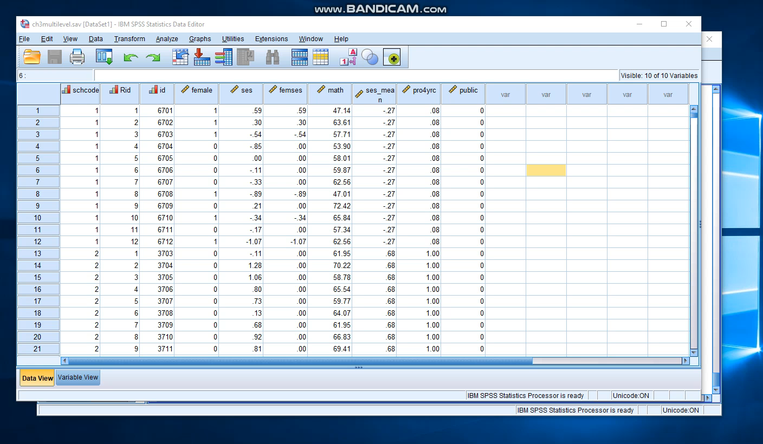

Slide 39
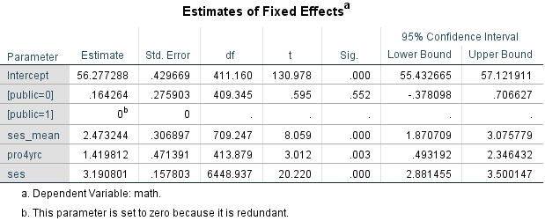
Step 3: building the group-level(or level 2) random intercept model
[school type as factor]
Public schools are coded 1, the second category is the reference group.
Controlling for the other predictors in the model, school type does not affect achievement (𝛄03=0.164, p>.05)
[pro4yrc]
The intercept is the outcome when there are no students in the school planning on attending a 4-year university.
→ center the variable on its grand mean
[ses_mean, SES]
z-score(mean=0, SD=1)
the effects of students SES background are significant at both the individual and school levels → compositional effect
The average school intercept of 56.28 is the predicted score for students in public schools when average school SES(ses_mean) is 0, where no students plan to attend 4-year institutions, and where individual SES is held at the grand-mean average. (Heck, Thomas, & Tabata, 2013)
Notes:
Level 2 predictive models describe how differences in school variables may influence individual processes within each school.
[pro4yrc] the proportion of students planning to attend 4-year universities after high school. For schools where this proportion is 0, the expected achievement intercept is 56.28. However, where all students are planning to attend a 4-year institution the expected achievement is 57.70. Due to the coding of this variable(range from 0 to 1), a change from 0 to 1 represents a 1 unit change. + considering interpretation, we might want to center this, there may not be any schools where no students are planning to attend a 4-year university.
[ses_mean, SES] This model indicates that the effects of students SES background are significant at both the individual and school levels. Compositional effect, or and effect that tends to compound across levels of the data hierarchy. The compositional effect is defined as the extent to which the size of the organizational effect differs from the person-level effect.

Slide 40


Slide 41
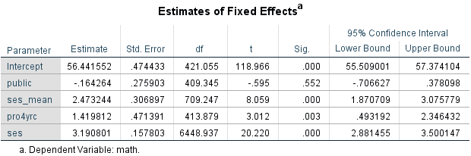
Step 3: building the group-level(or level 2) random intercept model
Public school defined as a factor
[School type as a covariate]
Intercept : 56.28 vs. 56.44
In the second model, the intercept presents the mean for private school. Public schools are now being 0.16 of a point lower.
If we add public sch intercept 0.16 and private estimate 56.28 from the first model, we still gain 56.44
Public school defined as a covariate

Slide 42
Step 3: building the group-level(or level 2) random intercept model
Two-Level Hierarchical Linear Models Estimating Student Math Achievement
 | Model 1 | Model 2 | Model 3
Fixed Effects
Student-level
SES |  | 3.874*** (0.137) | 3.191*** (0.158)
School-level
Public |  |  | -0.164 (0.276)
ses_mean |  |  | 2.473*** (0.307)
Pro4yrc |  |  | 1.420** (0.471)
Intercept | 57.674*** (0.188) | 57.596*** (0.133) | 56.442*** (0.474)
Random Effects
Variance within schools | 66.551*** (1.172) | 62.807*** (1.109) | 62.630*** (1.103)
Variance between schools | 10.642*** (1.029) | 3.469*** (0.539) | 2.395*** (0.444)
Standard errors in parentheses *p<0.5, **p<0.01, ***p<0.001

Slide 43
Step 4: adding a randomly varying slope (the random slope and intercept model)
RQ: Do the slopes vary randomly across schools, and if they do, is there a relationship between features of schools’ environments and the strength of the slope relationship?
U_{1j} are group-level residuals of the slopes of the individual-level explanatory variables SES_{ij}
Notes:
Assess whether any of the slopes of any of explanatory variables has a significant variance component between the groups. First we specify the SES-achievement slope as a randomly varying parameter in the model. This model is the random coefficient model.
This is for further analysis
We note that the substitution results in the more complex error term ( u 1 j SES ij ), which represents the Level 2 variance for the Level 1 SES-achievement slope ( 1 j ).

Slide 44


Slide 45
Step 5: explaining variability in the random slope (more complex random slopes and intercept models)
Adding cross-level interactions between explanatory group-level variables and those individual-level explanatory variables that had significant slope variation in Step 4.
Notes:
Including the table and interpretation

Slide 46
Interaction
Interactions of interest in MLM can be within a level or across levels.
The interaction between same level predictors (if included in the model) would be a within-level interaction.
If the interaction exists between different levels, it is across levels.
A cross-level interaction tests whether the relationship between level 1 independent variable and dependent variable differs when introduce level 2 variables or not.

Slide 47


Slide 48
Discussion
Types of research questions
Types of MLM
More About Missing Data
A shot at ELS 2002
Further exploration of multilevel modeling

Slide 49
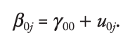
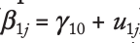
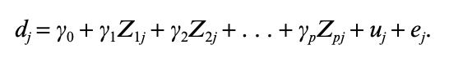
Kinds of Research Questions
a. Group Differences in Means
b. Group Differences in Slopes
c. Cross-level Interaction
d. Meta-analysis

Slide 50
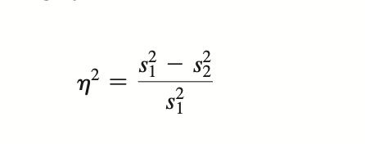
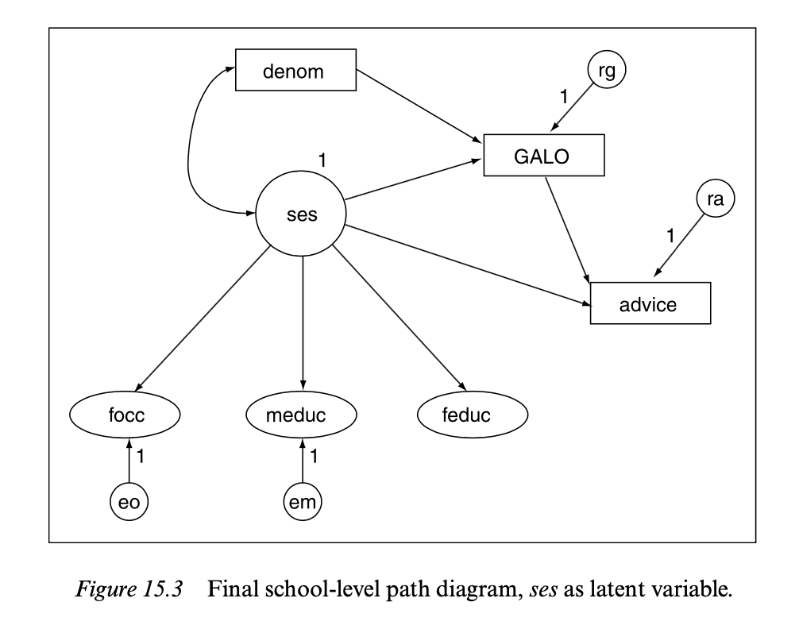
e. Effect Size
f. Relative Strength of Predictors at Various Levels
g. Path Analysis at Individual and Group Level
h. Multilevel Logistic Regression
i. Multiple Response Analysis
j. Analysis of Longitudinal Data

Slide 51
Types of MLM
a. Repeated Measures
b. Higher-order MLM
c. Latent Variables
d. Nonnormal Outcome Variables
e. Multiple Response Models

Slide 52
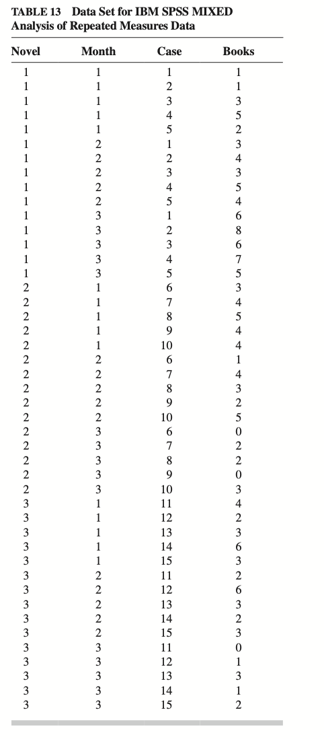
Analysis of Longitudinal Data
With Repeated Measures
To be continued with awesome group 3

Slide 53
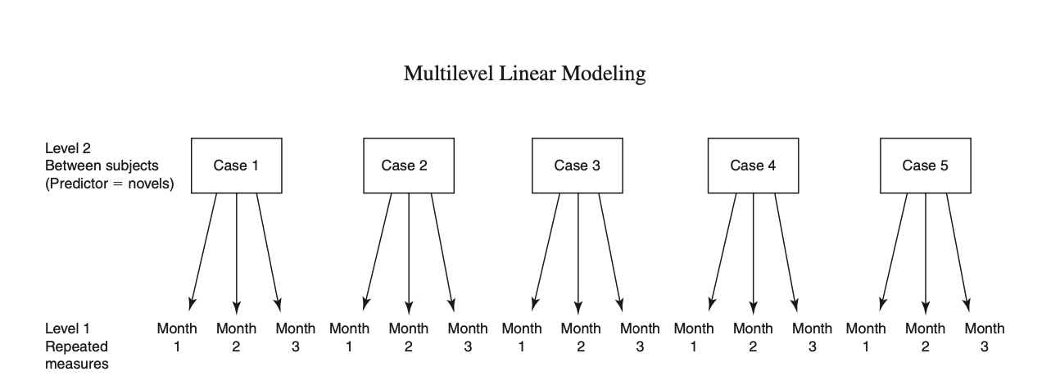

Slide 54
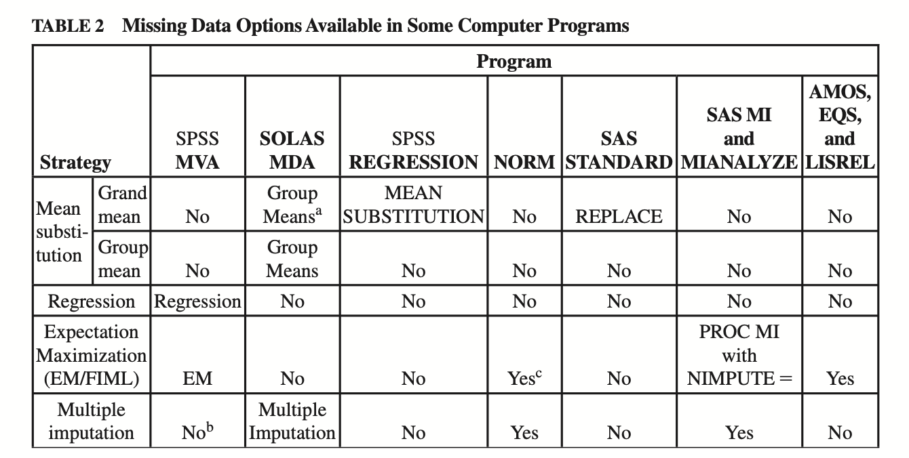
Dealing with missing data

Slide 55
Choosing Among Methods for Dealing With Missing Data
Observe their pattern to try to determine whether data are randomly missing.
Deletion of a variable with a lot of missing data is also acceptable as long as that variable is not critical to the analysis.
It is best to avoid mean substitution unless the proportion of missing values is very small and there are no other options available to you.
Using prior knowledge requires a great deal of confidence on the part of the researcher about the research area and expected results.
Regression methods may be implemented (with some difficulty) without specialized software but are less desirable than EM methods.
EM methods sometimes offer the simplest and most reasonable approach to imputation of missing data, as long as your preliminary analysis provides evidence that scores are missing randomly (MCAR or MAR).

Slide 56
Choosing Among Methods for Dealing With Missing Data
Multiple imputation is currently considered the most respectable method of dealing with missing data.
Using a missing data correlation matrix is tempting if your software offers it as an option for your analysis because it requires no extra steps.
Repeating analyses with and without missing data is highly recommended whenever any imputation method or a missing data correlation matrix is used and the proportion of missing values is high—especially if the data set is small.

Slide 57
For more information on dealing with missing data, a recommendation is linked here:
Schafer, J. L., & Graham, J. W. (2002). Missing data: Our view of the state of the art. Psychological Methods, 7(2), 147–177. https://doi-org.ezproxy.cul.columbia.edu/10.1037/1082-989X.7.2.147
Graham, J. W., Cumsille, P. E., & Elek-Fisk, E. (2003). Methods for handling missing data. In J. A. Schinka & W. F. Velicer (Eds.), Handbook of psychology: Research methods in psychology, Vol. 2 (p. 87–114). John Wiley & Sons Inc.

Slide 58
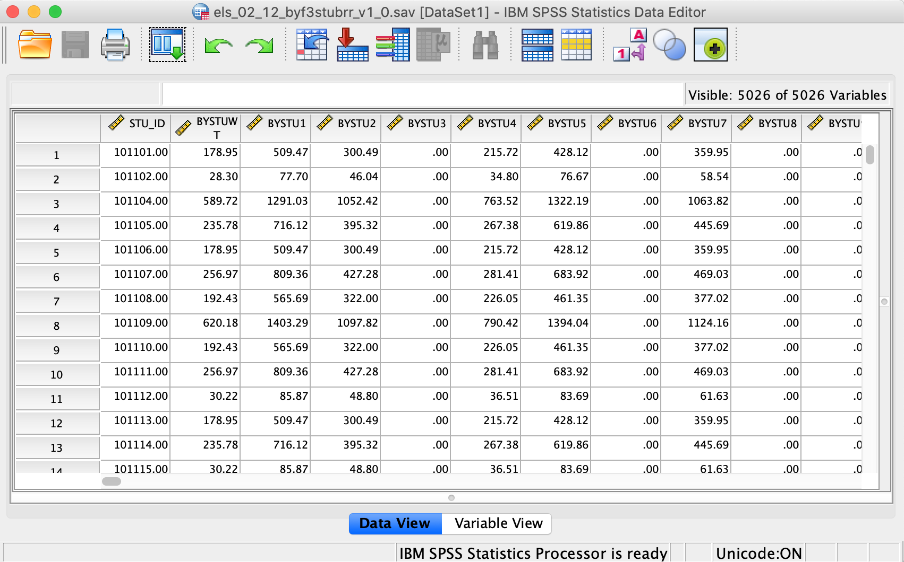
ELS 2002: Two Level IDs

Slide 59
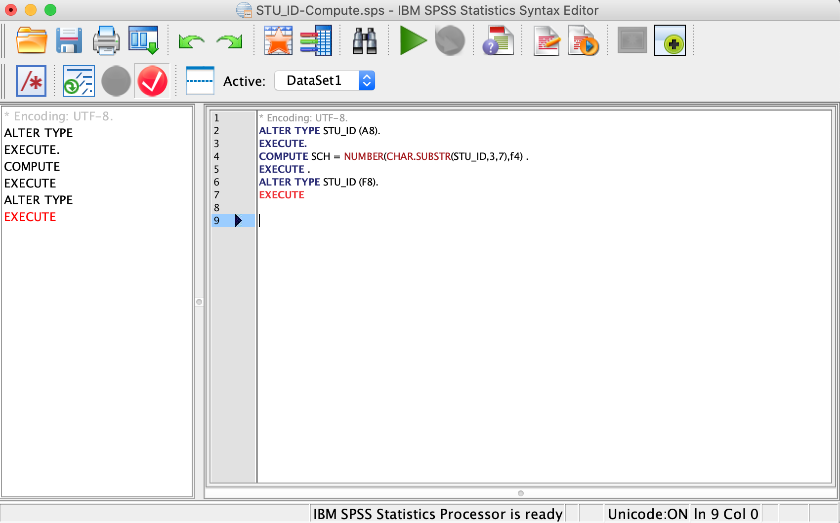
ELS 2002: Two Level IDs-Syntax

Slide 60
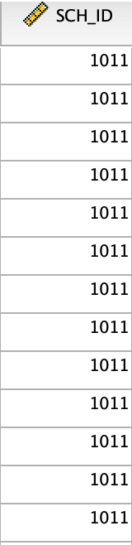
School ID

Slide 61
Conclusion: Final Checklist
1. Issues
a. Adequacy of sample sizes and missing data
b. Normality of distributions at each level
c. Absence of outliers at each level
d. Absence of multicollinearity and singularity
e. Independence of errors (intraclass correlation)
2. Major analyses
a. Analysis with first-level predictors
b. Analysis with second-level predictors and significant first-level predictors, etc.
c. Determination of final model
(1) Parameter estimates for final model
(2) Comparison of final with an intercepts-only model

Slide 62
Conclusion: Final Checklist
3. Additional analyses
a. Adding main effects and/or interactions
b. Additional exploratory analyses

Slide 63
References
Heck, R. H., Thomas, S. L., & Tabata, L. N. (2013). Multilevel and Longitudinal Modeling with IBM SPSS (2nd ed.). New York, NY: Routledge. 978-0415817110
O'Dwyer, L. M., & Parker, C. E. (2014). A primer for analyzing nested data: Multilevel modeling in SPSS using an example from a REL study. Washington, DC: U.S.Department of Education, Institute of Education Sciences, National Center for Education Evaluation and Regional Assistance, Regional Educational Laboratory Northeast & Islands. http://ies.ed.gov/ncee/edlabs/regions/northeast/pdf/REL_2015046.pdf
Xia, J., Izumi, M., Gao, X. (2015) School Process and Teacher Job Satisfaction at Alternative Schools: A Multilevel Study Using SASS 2007–08 Data. Leadership and Policy in Schools, 14(2), p.167-203. http://doi.org/10.1080/15700763.2014.997935
Hox, J. J., Moerbeek, M., & Van de Schoot, R. (2010). Multilevel analysis: Techniques and applications. Routledge.

Slide 64
Thank You! Any Questions?
Aki Osawa (ao2669@tc.columbia.edu)
Soojin Lee (sl4400@tc.columbia.edu)
Jingru Zhang (jz3101@tc.Columbia.edu)

